Slide 1
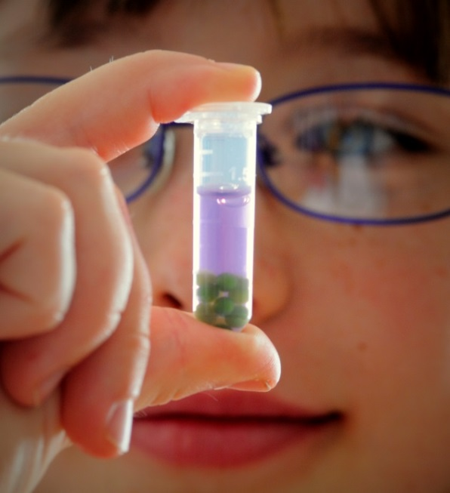
Algae Blooms: Agriculture, Ecology, and Economy
Bio-Rad Biotechnology Explorer
Photosynthesis and Cellular Respiration Kit for AP Biology

Slide 2
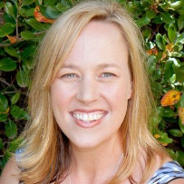
Curriculum and Training Specialists
Damon Tighe
Leigh Brown
Tamica Stubbs
bio-rad_explorer@bio-rad.com

Slide 3
Classroom Context & Inquiry: Dead Zone of the Gulf of Mexico
What
Causes the Dead
Zone?

Slide 4
Workshop Outcomes
How can you use immobilized algae cells to demonstrate the capture of CO₂ from the environment during photosynthesis and the release of CO₂ into the environment during cellular respiration?
How can you take quantitative and qualitative measurements of photosynthesis and cellular respiration rates, to illustrate CO₂ movement?
How can you engage students in an authentic inquiry activity that applies concepts relating to photosynthesis and cellular respiration into one lab?

Slide 5
What could that liquid be?
Note the initial color of the liquid in the cup.
Use the straw to gently blow into the liquid for about 5 seconds.
In groups, discuss any changes you observed.
?
Notes:
Observation-> What do you think causes the change? -> Directly measures? -> Indirectly measures?
How can we use this indicator solution to open the door to student questioning the relationship between PS & CR?

Slide 6
Observations
What did you observe?
Color changed from red (or red-orange) to yellow!
?
Notes:
Observation-> What do you think causes the change? -> Directly measures? -> Indirectly measures?
How can we use this indicator solution to open the door to student questioning the relationship between PS & CR?

Slide 7
Think like your students…
How many of your students will remember that plants do BOTH photosynthesis and cellular respiration?
Do they understand how PS and CR are connected?

Slide 8
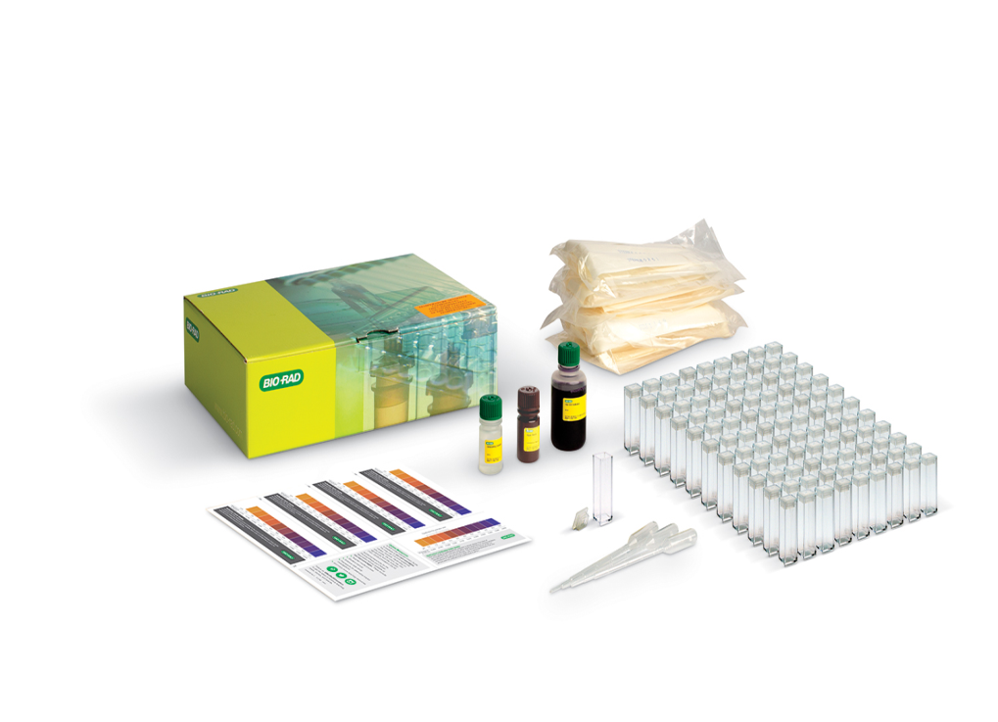
Our Photosynthesis & Cellular Respiration Kit helps to bridge the connection!
Kit Design: Applicable to Biology (Gen Bio -AP) and Environmental Sciences with a teaching emphasis on inquiry-based experiments.
Algae Beads: Live algae (Scenedesmus obliquus) are immobilized in alginate as “beads”. The algae can photosynthesize and respire while beaded.
CO₂ Indicator: Colorimetric pH indicator allows for qualitative and quantitative data collection.

Slide 9
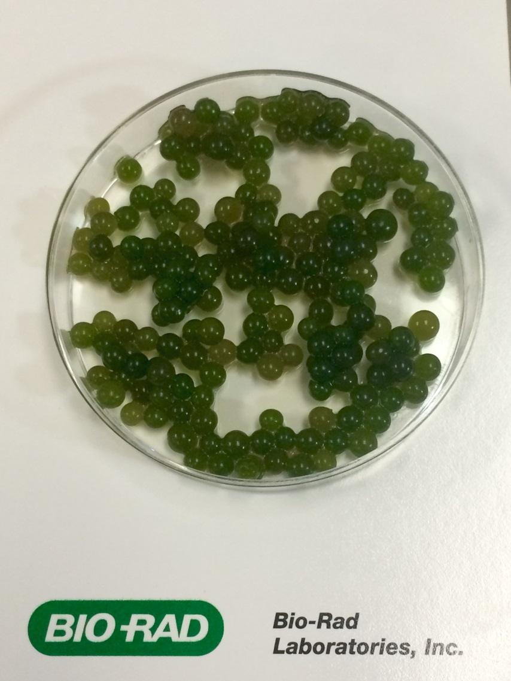
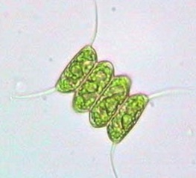
Algae Beads are AWESOME!
Beads are easy for students to handle and move
Algae can be reused for multiple
Experiments
Algae beads have more then a month
shelf life and require minimal prep
Algae beads
(~ 2 mm)
Algae beads are easy to dispose

Slide 10
CO₂ Indicator – how does it work?
CO₂ combines with water to make carbonic acid (H₂CO₃).
More CO₂ = more carbonic acid = pH = more
?
?
Higher / lower?
Yellow / purple?
CO₂ in solution

Slide 11
CO₂ (pH) Indicator
CO₂ combines with water to make carbonic acid (H₂CO₃).
MORE CO₂ = more carbonic acid = LOWER pH = more YELLOW
CO₂ in solution

Slide 12
CO₂ (pH) Indicator
CO₂ combines with water to make carbonic acid (H₂CO₃).
What happens when we have LESS CO₂?
CO₂ in solution

Slide 13
CO₂ (pH) Indicator
CO₂ combines with water to make carbonic acid (H₂CO₃).
LESS CO₂ = less carbonic acid = HIGHER pH = more PURPLE
CO₂ in solution

Slide 14
Putting it all together
Dark
cellular respiration (CO₂ production)
pH decreases
yellow
Light
photosynthesis (CO₂ consumption)
pH increases
purple
CO₂ in solution

Slide 15
Procedure
Cut transfer pipette at 250 ul mark
Transfer 10 beads to 2 cuvettes labeled dark and light

Slide 16
Procedure
3. Remove excess liquid from cuvette
4. Add 1 ml of distilled water to both cuvettes and incubate for 5 minutes
H₂O 1 ml

Slide 17
Procedure
5. Remove water
6. Add 1 ml C0₂ Indicator to both cuvettes and cap
H₂O
1 ml indicator

Slide 18
Procedure
7. Record initial pH / Absorbance for each cuvette and put one cuvette in the dark (foil) and one in the light with beads spread out
8. Record changes in pH and Absorbance every 5 min

Slide 19
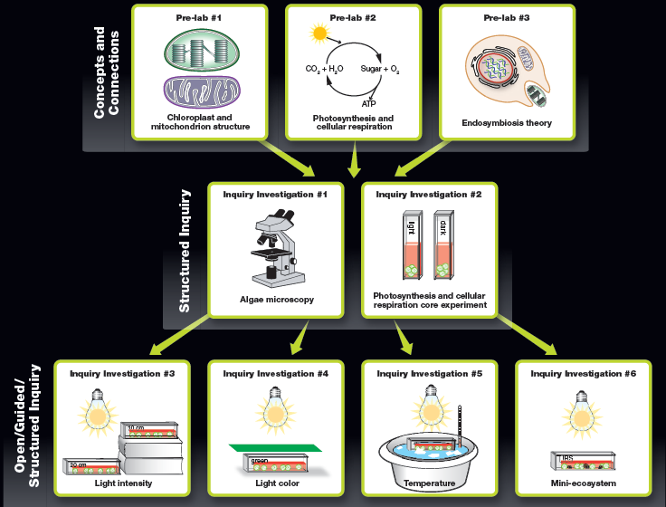
Lab Summary - Workflow

Slide 20
Gulf of Mexico Dead Zone Resources
https://serc.carleton.edu/microbelife/topics/deadzone/index.html

Slide 21
ThINQ! Resource Page
bio-rad.com/ws/ThINQresources
Get teaching resources:
videos
case studies
class activities

Slide 22
Full Kit: 17001238EDU $145 Explorer Catalog pg. 12 Refill Kit: 12002353EDU $119 debeading solution, indicator, and beads
Photosynthesis & Cellular Respiration Kit
Photosynthesis and Cellular Respiration Kit for AP Biology

Slide 23
How to Buy

Slide 24
Please take our survey!

